Slide 1

Functional Modification Specification
Salesprice simulation
Milani Damiano
Vimercati Davide
Tan Yan Shao
Oguntoyinbo Oludayo
18-11-2011

Slide 2
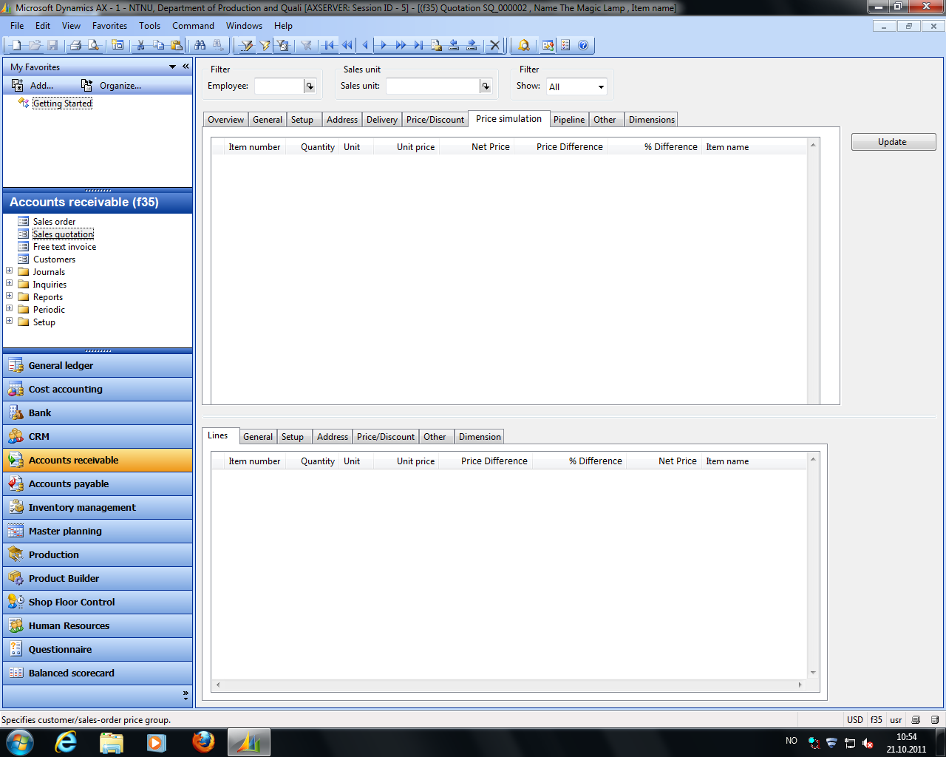
FMS – Interface overall

Slide 3
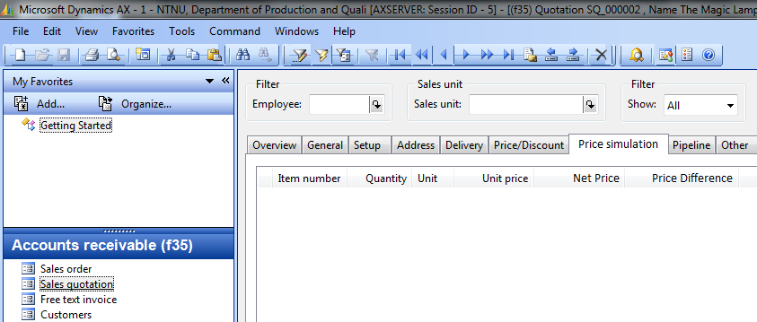
FMS - Modification

Slide 4

FMS – Top view

Slide 5
FMS – Bottom view

Slide 6
FMS – Example
Item: Valve
Salesprice modification at component-level
Valve
x1
Valve disk
x2 Gaskets
Unit price:
10,00
20,00

Slide 7
FMS – Example
VLV-01
1
pcs
50,00
50,00
0
0
Valve

Slide 8
FMS – Example
VDSK-3
1
pcs
10,00
0,00
5
10,00
Valve Disk
0
-3,00
GSK-41
2
pcs
20,00
0,00
0
20,00
Valve Gasket

Slide 9
FMS – Example
VDSK-3
1
pcs
10,00
0,50
5
10,50
Valve Disk
GSK-41
2
pcs
20,00
-3,00
-15
17,00
Valve Gasket

Slide 10
FMS – Example
VLV-01
1
pcs
50,00
44,50
-5,50
-11
Valve

